Slide 1

FinOptimal
A tool for visual management and analysis of personal or institutional asset portfolios.
By Team3—— DataWealth

Slide 2

01
Our Team
02
Our Project
03
Conclusion
04
The Road Ahead

Slide 3

01
PART ONE
Our Team

Slide 4

Our Team—— DataWealth
Colin Tang
UI Integration, Interface Improvement…
API Interface Debugging
Yuna Liu
Asset List and Modification Page
API Interface Debugging
Echo Zhou
Presentation, Responsible for Database
Portfolio Assets Page
Ivy Lv
Jensen Song
Create a Portfolio Model, Portfolio List Page，Backend Code Maintenance
Create Portfolio API，API Document
API Interface Debugging
Notes:
Composed of
The part we are responsible for is as shown in the slides.

Slide 5
02
PART TWO
Our Project

Slide 6

Background
Growing complexity in asset allocation increases the need for effective portfolio management;
Existing tools are often not beginner-friendly or lack visualization flexibility.
Our Goal
Call external APIs and databases to support browsing portfolios and viewing portfolio performance；
Implement basic portfolio management, adding and deleting assets, etc.
Notes:
Have you ever encountered such a situation like this: investment data is scattered, management is cumbersome, and you have to use several systems to check the yield of a portfolio?
In the current complex context, having an efficient and customizable portfolio management system has become a necessary need for many fund companies and clients.
Therefore, we decided to develop a simple and effective portfolio management system to track and analyze the performance of multiple assets (such as stocks, bonds, and cash), helping users better understand their investments.
Objectives:
call a external API for managing investment data
Build an interactive front-end for asset display and data charts
Visualize key metrics like profit/loss, allocation, and asset types
Strengthen teamwork and engineering practices through real-world development

Slide 7
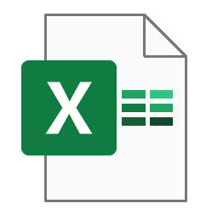

Project Management
Module
Portfolio, Asset, General
Responsible
Task ID
Who is responsible for this task?
Task Name
Status
Get all portfolio APIs，Asset List Page，Database Initialization
Completed, In progress…
Task.xlsx
Priority
Description
High, medium or last?
Description for every task
Type
Backend or frontend ?
Notes:
给任务分类 classify tasks

Slide 8
Tech Stack
Project Management
Excel
Framework
Express, Restful
15%
20%
Version Control Tools
Git
Database
mySQL
Development Language
JavaScript, CSS

Slide 9
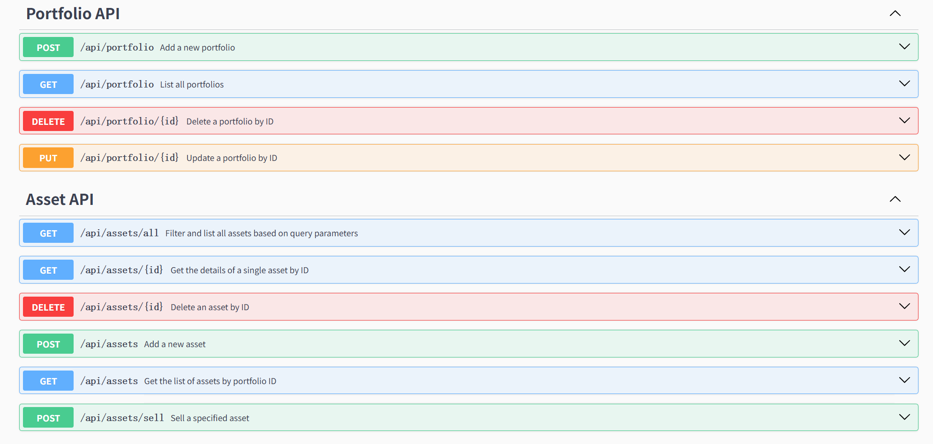
Tech Stack---- External API
Notes:
This is the document of the external API we call, which can perform CRUD operations.

Slide 10
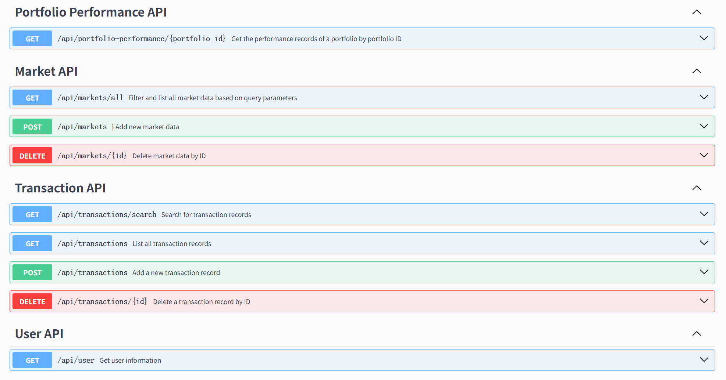
Tech Stack---- External API

Slide 11
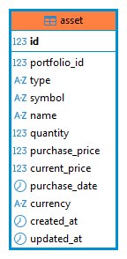
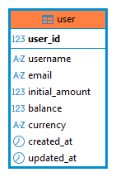
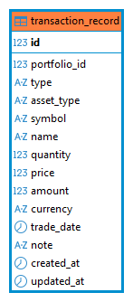
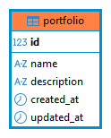
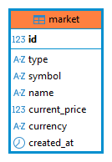
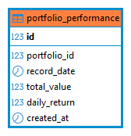
Tech Stack---- DataBase

Slide 12


Feature Flow
01
All Assets Page
02
External API Page
03
TransactionRecords Page
04
Portfolio Assets Page
05
InvestSystemPage
Notes:
Our system consists of different pages, each of which implements a different function, and the specific content wll be displayed

Slide 13
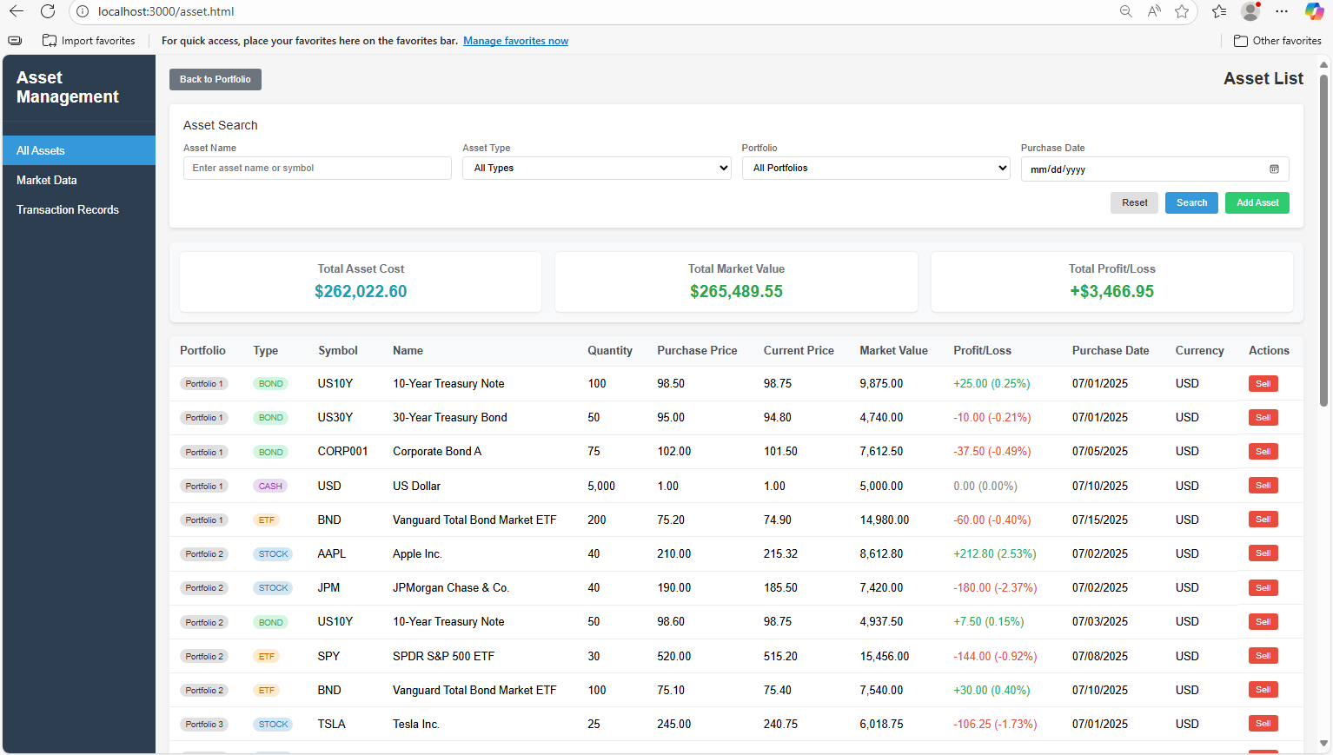
Feature Flow
All Assets Page
01
according to your need to draw the text box size
02
ADD TITLE
according to your need to draw the text box size
03
ADD TITLE
according to your need to draw the text box size
04
ADD TITLE
according to your need to draw the text box size

Slide 14
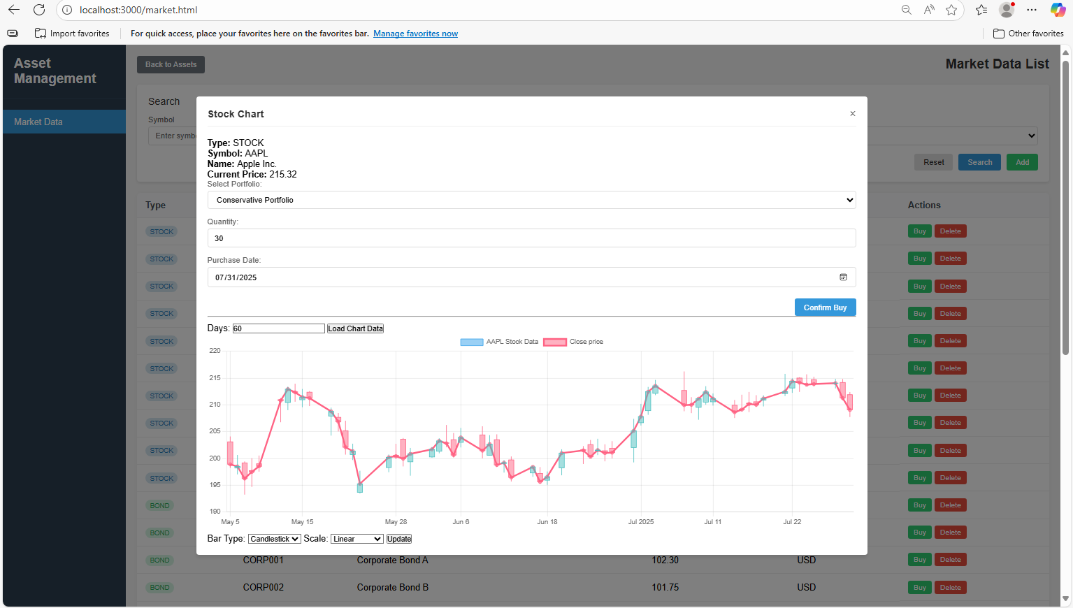
Feature Flow
External API Page
01
according to your need to draw the text box size
02
ADD TITLE
according to your need to draw the text box size
03
ADD TITLE
according to your need to draw the text box size
04
ADD TITLE
according to your need to draw the text box size

Slide 15
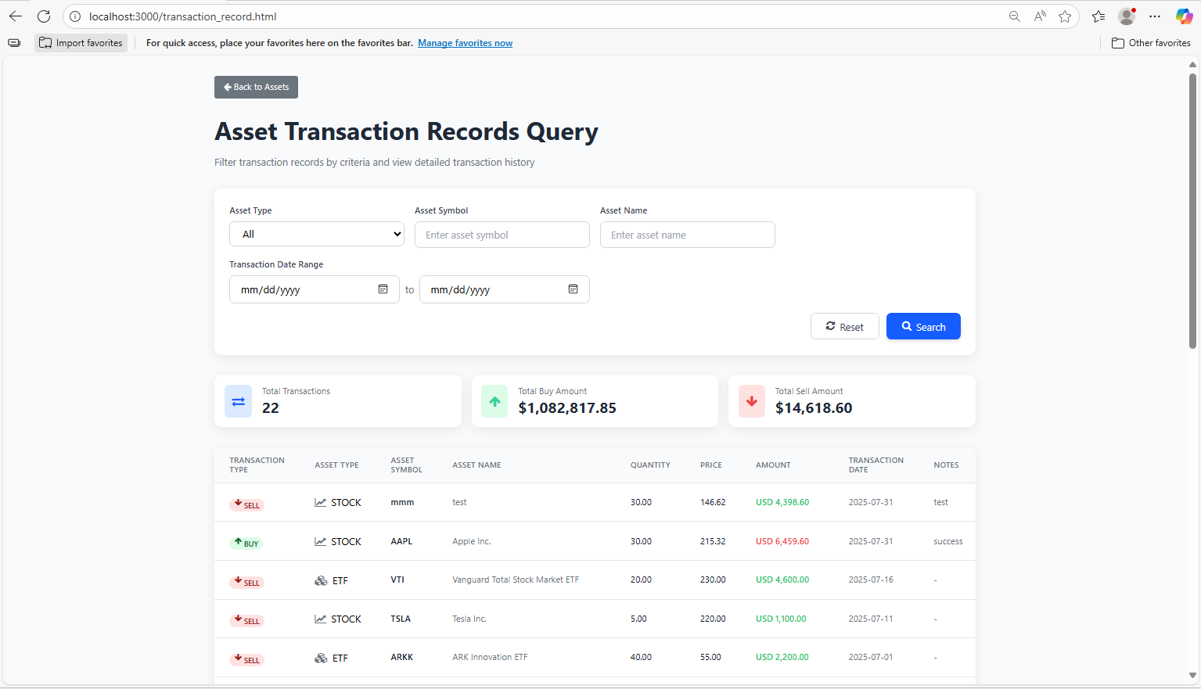
Feature Flow
TransactionRecords Page
01
according to your need to draw the text box size
02
ADD TITLE
according to your need to draw the text box size
03
ADD TITLE
according to your need to draw the text box size
04
ADD TITLE
according to your need to draw the text box size

Slide 16
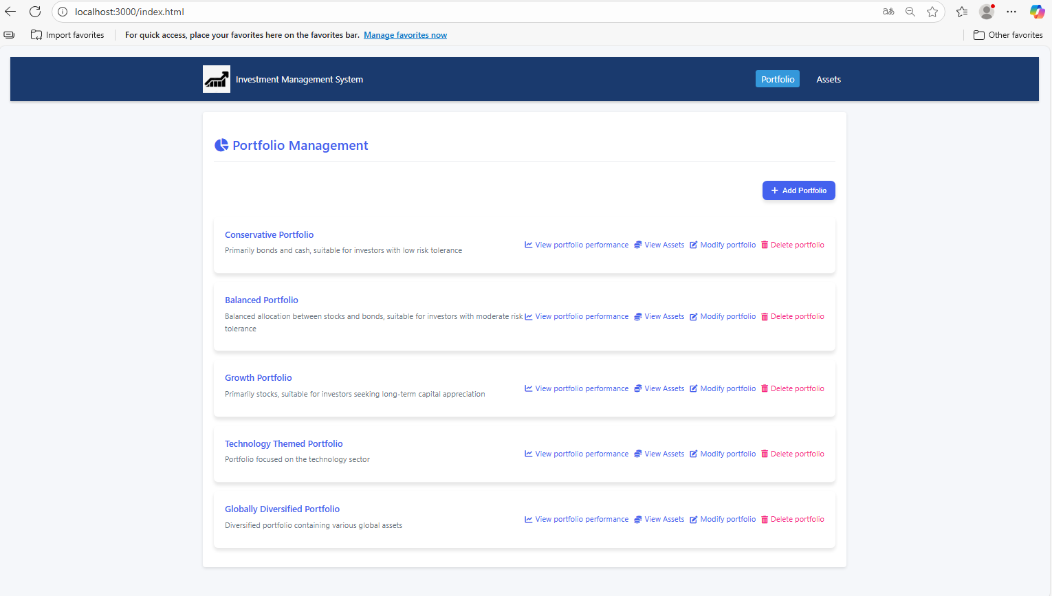
Feature Flow
InvestSystemPage
01
according to your need to draw the text box size
02
ADD TITLE
according to your need to draw the text box size
03
ADD TITLE
according to your need to draw the text box size
04
ADD TITLE
according to your need to draw the text box size

Slide 17
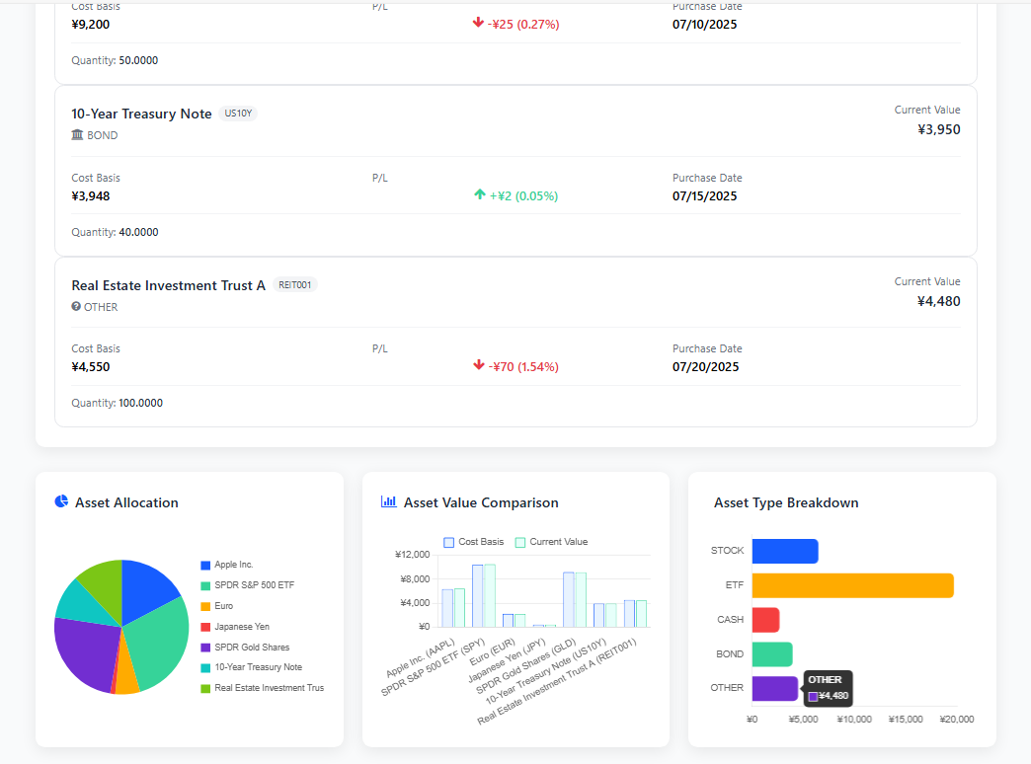
Feature Flow
Portfolio Assets Page
Display asset details in a list
Compare current value and initial investment
Pie chart for asset proportion
Asset type distribution
Notes:
It fetches asset data from the backend API /api/assets using the provided portfolio_id and displays it through interactive charts and lists.
Display asset details in a list
•✅ Dynamic pie chart for asset proportion, The graph is dynamic, and when you click on different parts, detailed information such as percentage and so on will be displayed.
•✅ Bar chart for comparing current value and initial investment to get profit.
Profits are also shown in the list above. The green number indicates that you have made a profit of $445, which is a 4.6% increase. The red number indicates that you have lost $760, which is an decrease of 1.19%. By comparing the highs and lows of the bar chart, you can also see whether you have made a profit or a loss.
•✅ Bar chart for asset type distribution.

Slide 18
System Architecture Diagram
Frontend App
HTML/JS
Browser
Database
User Interface:
All Assets Page,
Transaction Records Page, InvestSystem Page, ……
Backend Server
JS/API

Slide 19
03
PART THREE
Conclusion

Slide 20
Advantagement
Decision Support
We integrate real-time data and visual analysis tools to help managers quickly obtain data support before making investment decisions.
Efficiency Improvement
Within 1 minute, users can import investment data and view portfolio return and risk indicators.
Technical Advantages
The system has stable performance and is easy to maintain.
Notes:
If you use the system we designed, you will find that portfolio management has never been so efficient. We hope we can become the most reliable "second brain" for your team's decision-making.

Slide 21




Conclusion
Learned the importance of team coordination, modular design & data integrity.
Gained full-stack experience: API call, frontend ＆ backend.
G
L
P
S
Potential use:
1. Help clients or analysts visualize asset breakdown & gains/losses.
2.Support digital wealth advisory or internal demos.
Solve problems with data accuracy and chart integration.
Notes:
Through the development of our combined visualization tools, we have gained practical experience throughout the entire software development cycle - from the initial requirements analysis and API calls, to front-end development, data processing, and the use of interactive charts for visual representation.
We have learned how important clear communication, modular design and data consistency are in team-based development. Although this project was a valuable learning experience, we also encountered some difficulties. For instance, synchronizing the front-end and back-end interfaces requires more effort than expected, and debugging and chart configuration also take longer than anticipated.
We think in finance, such tools can help junior analysts or clients understand the composition of their investment portfolios more effectively. It can be used for internal presentations or customer-facing dashboards to illustrate asset allocation, profit and loss performance, and diversification - all of which are crucial for wealth management and consulting services.

Slide 22
04
PART FOUR
The Road Ahead

Slide 23
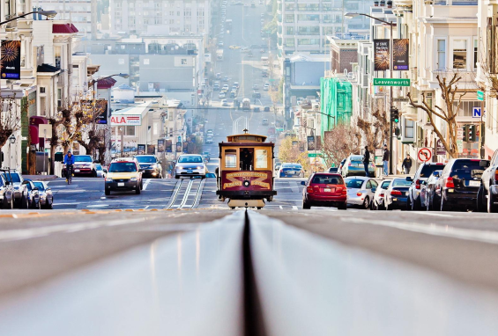



The Road Ahead
Enhance the system's functions
User authentication, asset class filters, and real-time price updates through financial apis.
Implement persistent storage
A SQL or NoSQL database and add downloadable reports or performance history graphs for users.
Notes:
If we had more time, we would enhance the system with features like asset category filters, and real-time price updates through financial APIs. Additionally, we would implement persistent storage (e.g., a SQL or NoSQL database) and add downloadable reports or performance history charts.
如果我们有更多的时间，我们会增强系统的功能，如用户认证，资产类别过滤器，并通过金融api实时价格更新。此外，我们将实现持久存储（例如，SQL或NoSQL数据库），并添加可下载的报告或性能历史图表。

Slide 24
Thank you!

